Slide 1
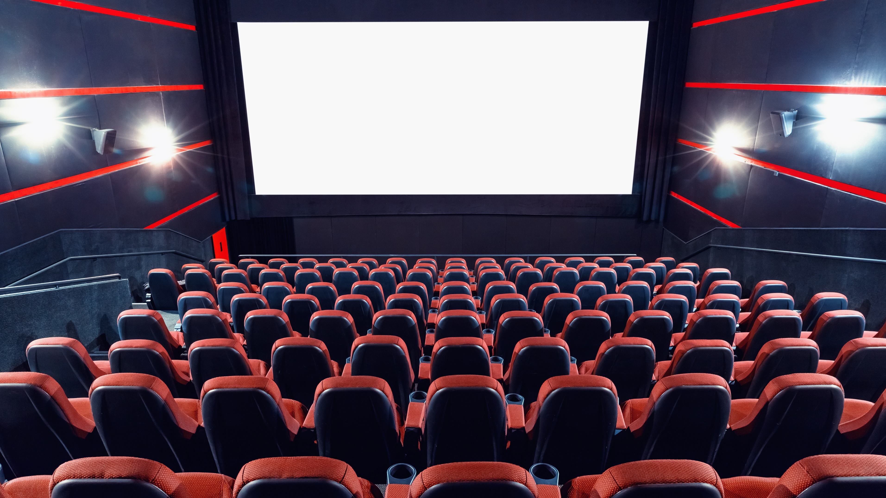

Movie Prediction Analysis
Erick Rodriguez
Jun Zhang
Shiva Velichala
Steve Sroba
Group 7

Slide 2

Agenda
Variable correlations and distributions
Dataset transformation and cleaning
Unsupervised learning
Supervised learning
Conclusions and future steps

Slide 3
Agenda
Variable correlations and distributions
Dataset transformation and cleaning
Unsupervised learning
Supervised learning
Conclusions and future steps

Slide 4



Business Questions
Based on a person’s characteristics, can we predict whether they will like a movie or not?
Based on previous ratings, can we recommend a movie?
Based on the movie genres, can we recommend certain genre?
What are the similarities between people that watch certain kind of movie? Can we recommend movies based on this similarities?

Slide 5
MovieLens Dataset
(1 million ratings from 6000 users on 4000 movies)
Ratings
UserID
MovieID
Timestamp
Rating
Movies
Title
Year
Genres(s)
Users
UserID
Gender
Age
Occupation
Zip Code

Slide 6
Cleaning the Data
Matched the userID and movieID between the data sets
Split title (year) into separate title and year
Split Genre(s) into binary variable, 1 column for each genre
Converted rating to binary variable “like” that is 1 if rating >= 3
Calculated the average rating and popularity (number of ratings) for each movie
Calculated the average rating by genre for each user
Converted the zip code to a state level

Slide 7
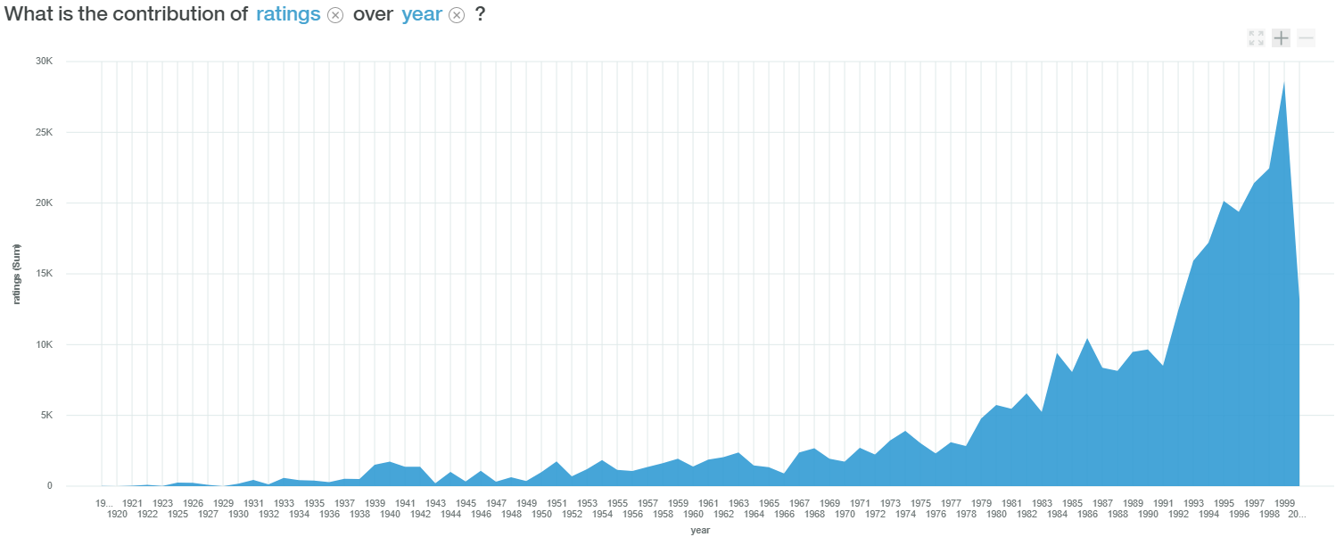
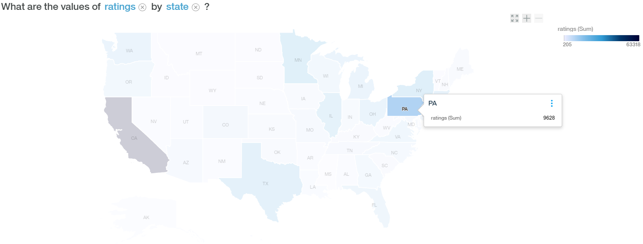
Variables Correlations

Slide 8
Variables Correlations

Slide 9
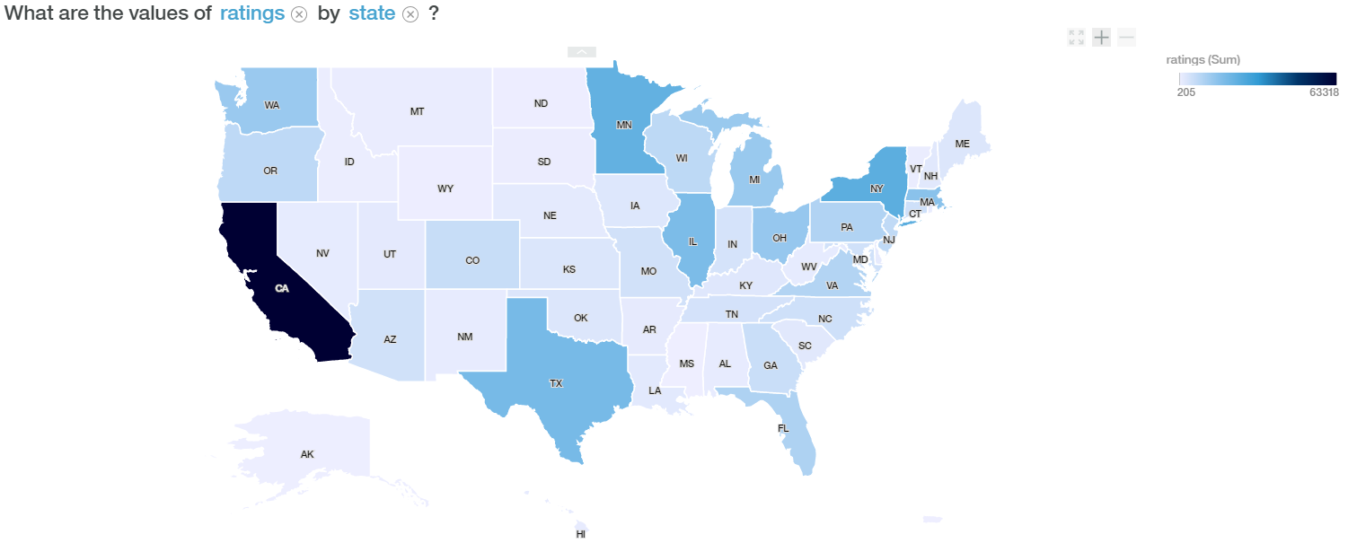
Variables Correlations

Slide 10
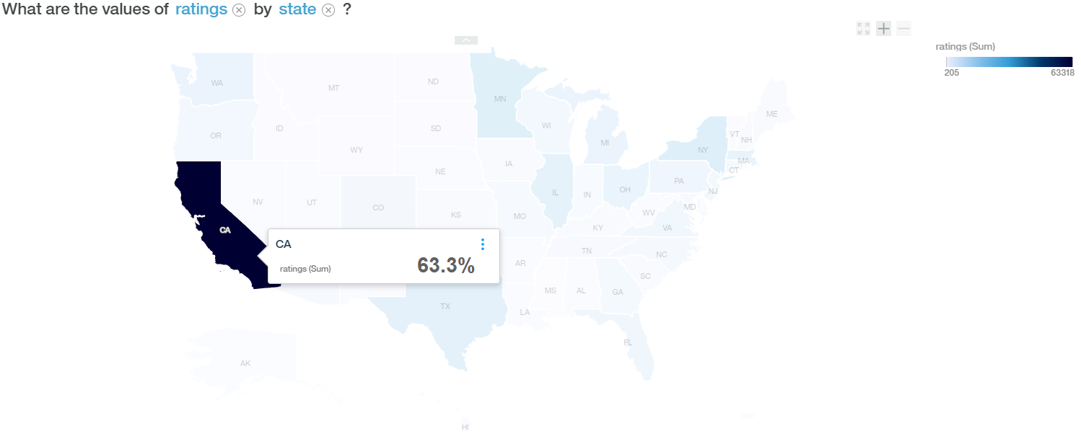
Variables Correlations

Slide 11
Variables Correlations

Slide 12
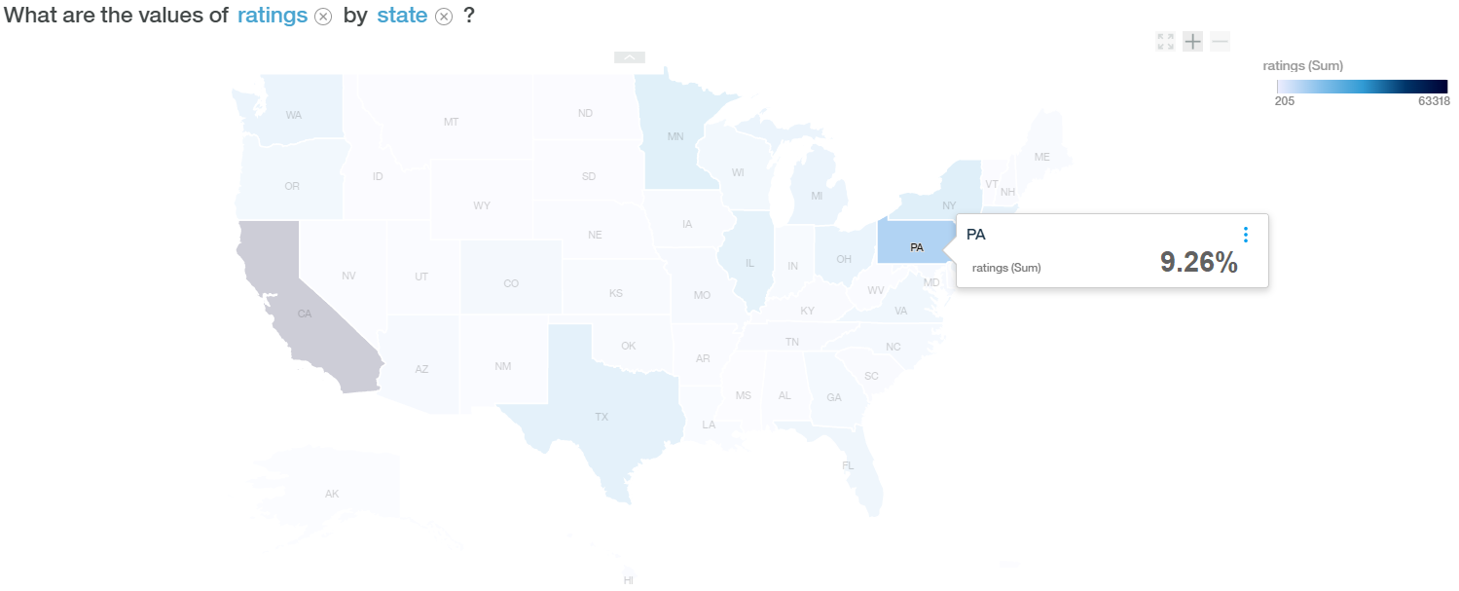
Variables Correlations

Slide 13
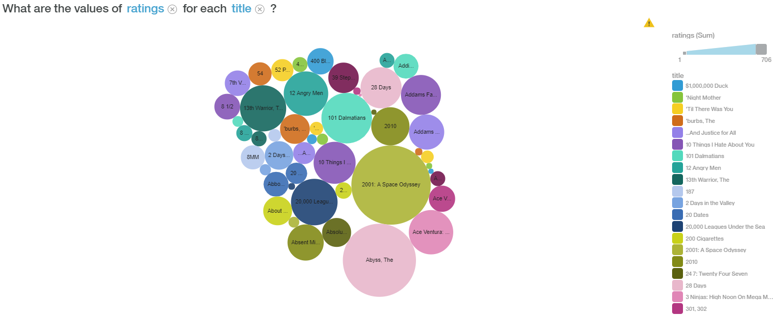
Variables Correlations

Slide 14
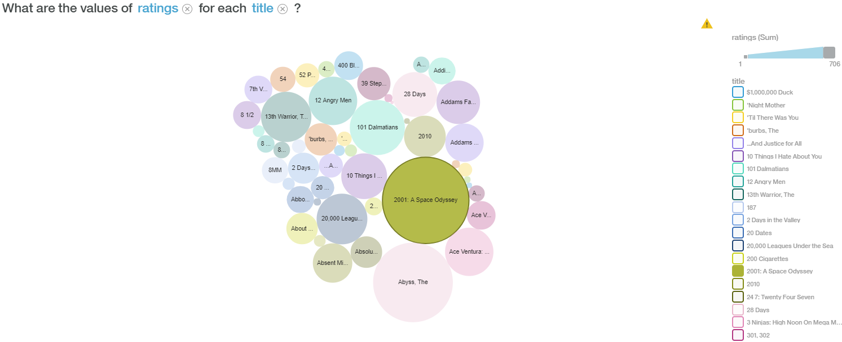
Variables Correlations

Slide 15
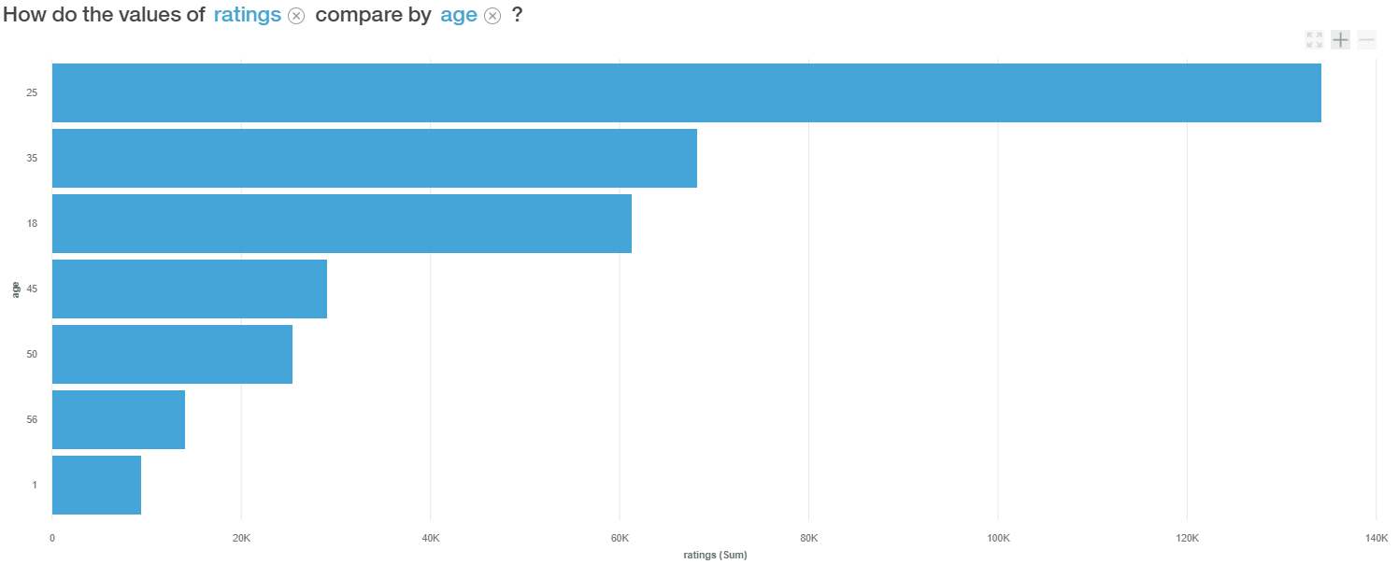
Variables Correlations

Slide 16
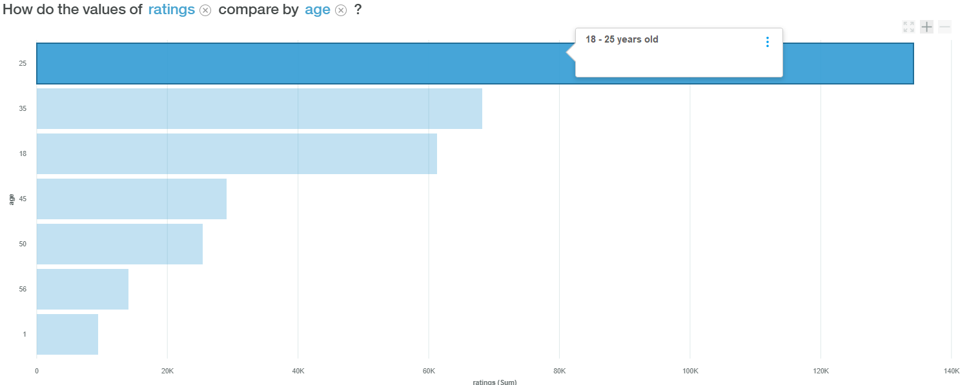
Variables Correlations

Slide 17
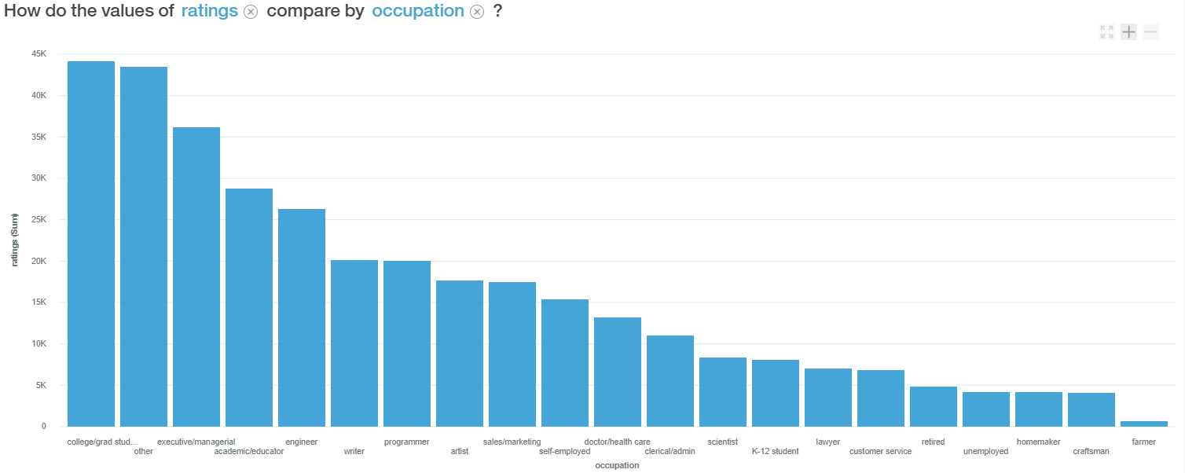
Variables Correlations

Slide 18
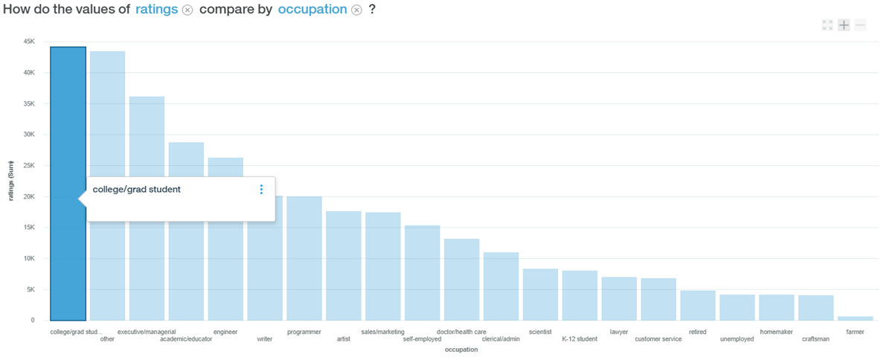
Variables Correlations

Slide 19
Variables Distributions

Slide 20
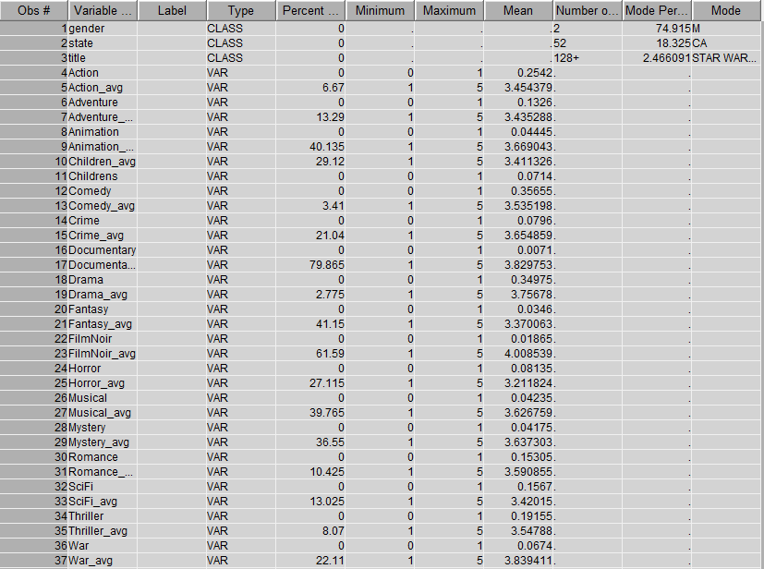
Data Exploration

Slide 21
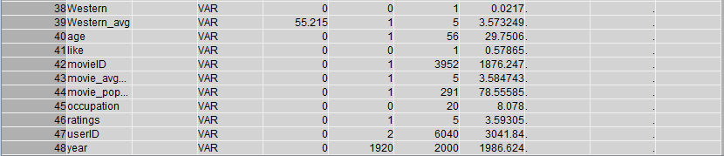
Data Exploration

Slide 22
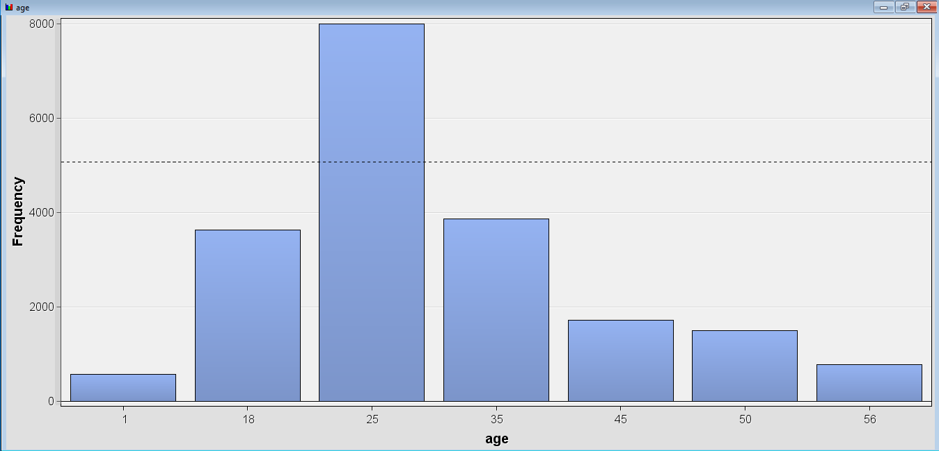
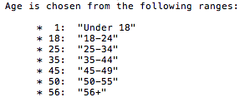
Age Distribution

Slide 23
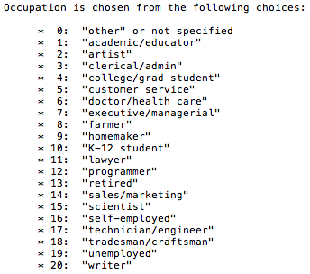
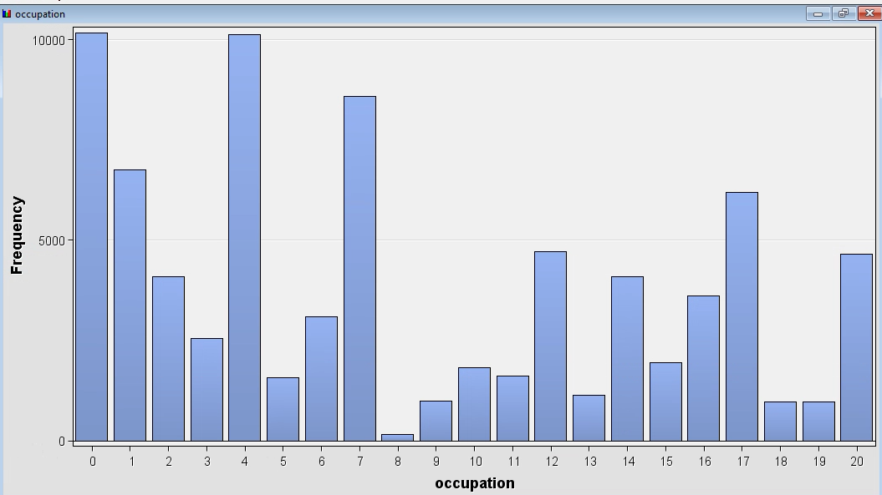
Occupation Distribution

Slide 24
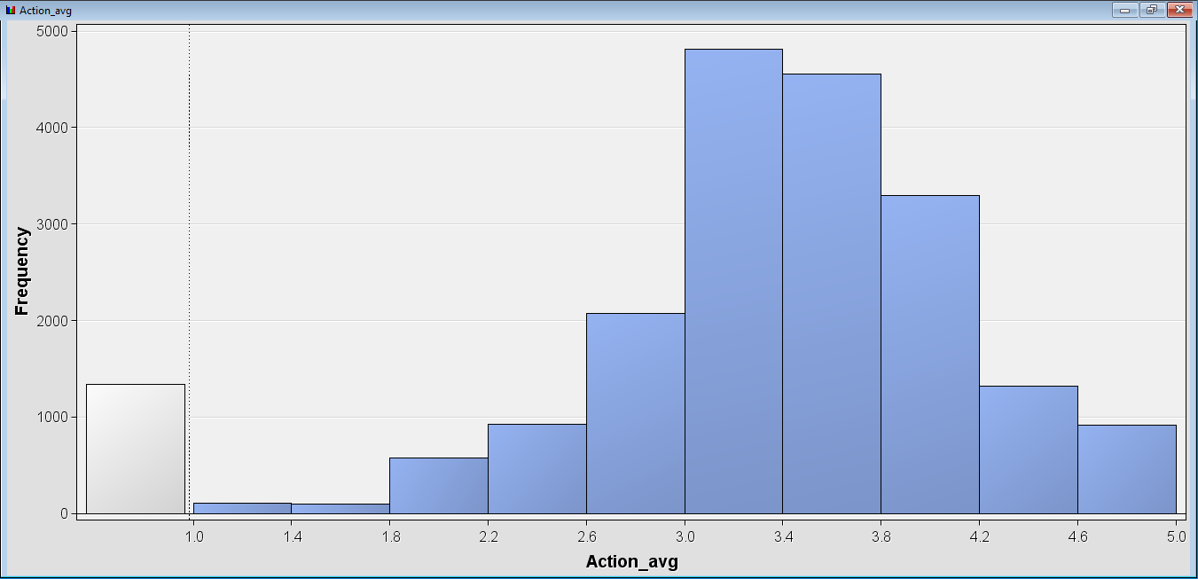
Distribution of Average Rating in Action Movies

Slide 25
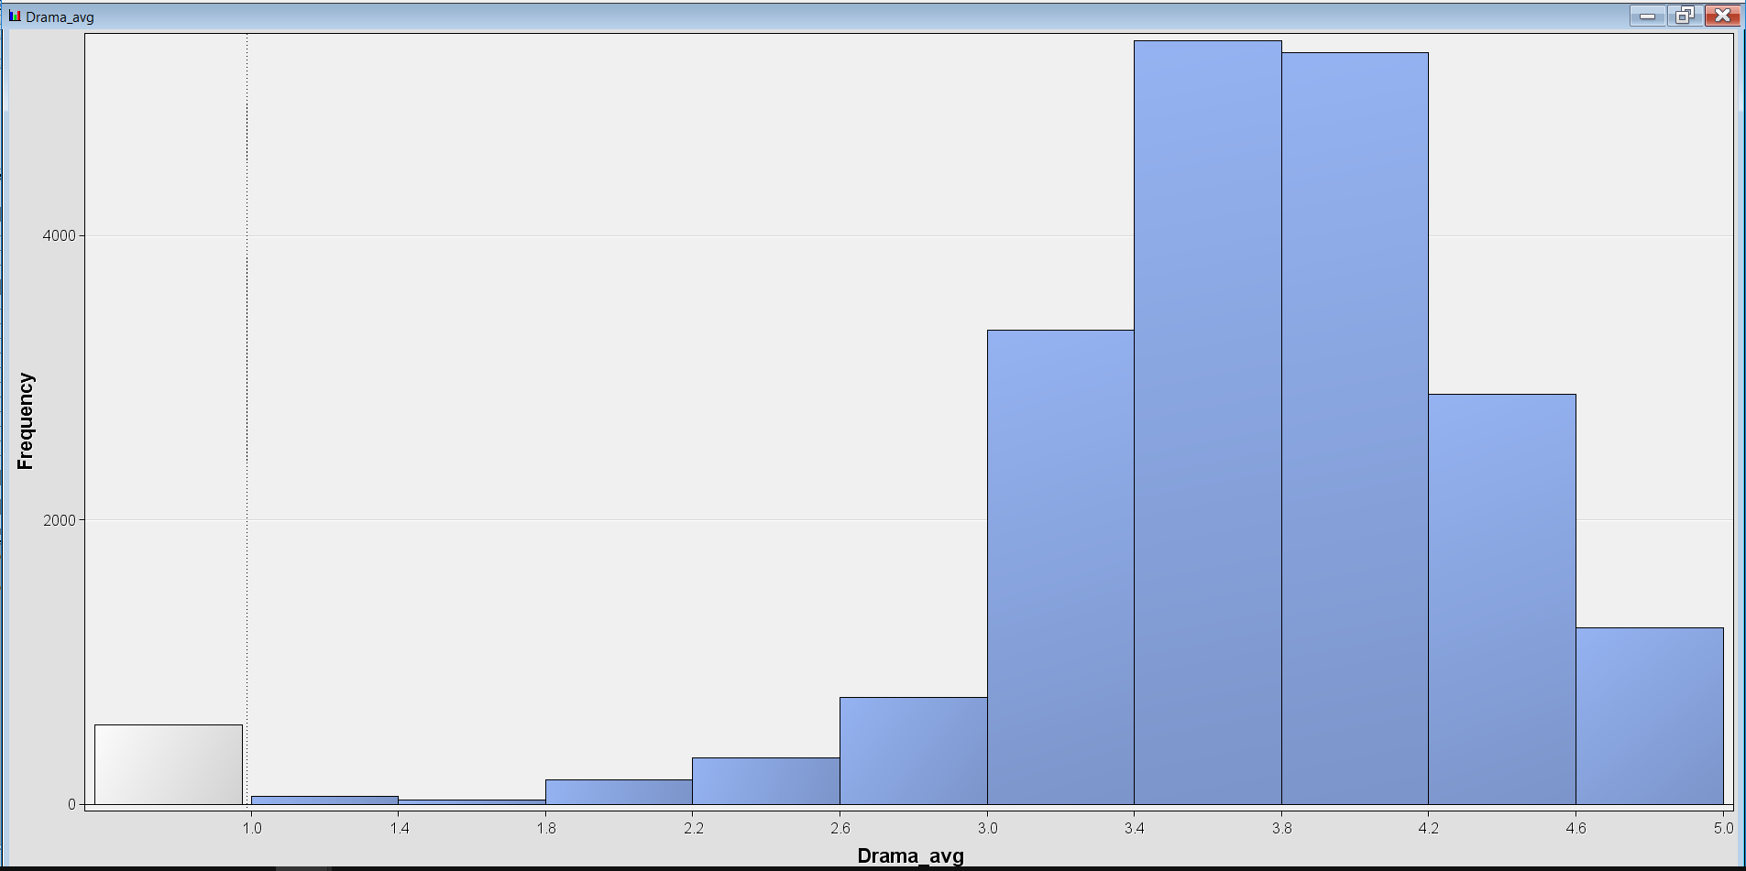
Distribution of Average Rating in Drama Movies

Slide 26
Agenda
Variable correlations and distributions
Dataset transformation and cleaning
Unsupervised learning
Supervised learning
Conclusions and future steps

Slide 27
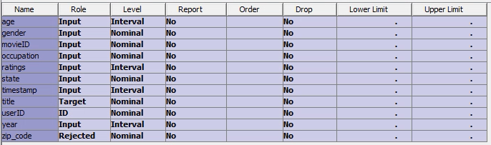
Association Rules

Slide 28
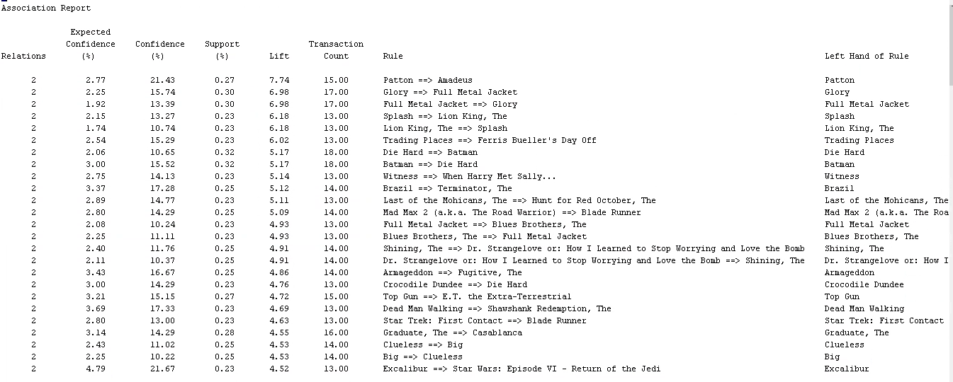
Two Item Association

Slide 29
Clustering
Clustering users based on user demographics
Clustering based on age, gender, occupation, and state variables
People in the cluster are very similar in their movies preferences and hence we can recommend a movie that is watch by majority of the users in the cluster to a user who has not yet watched it.

Slide 30
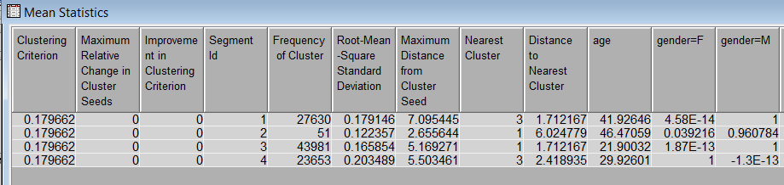
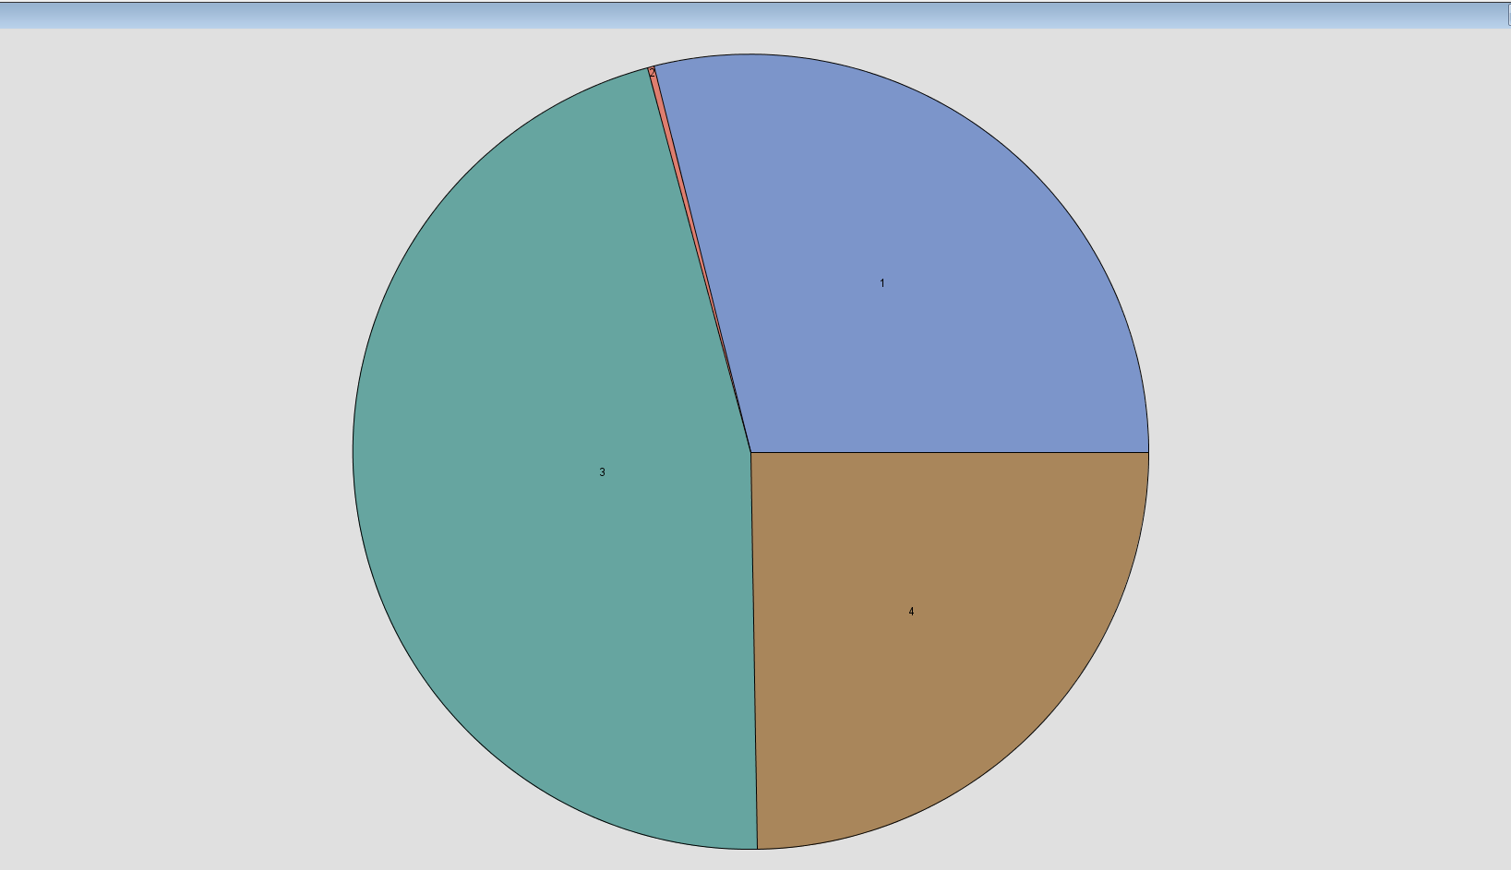
Clustering Results

Slide 31
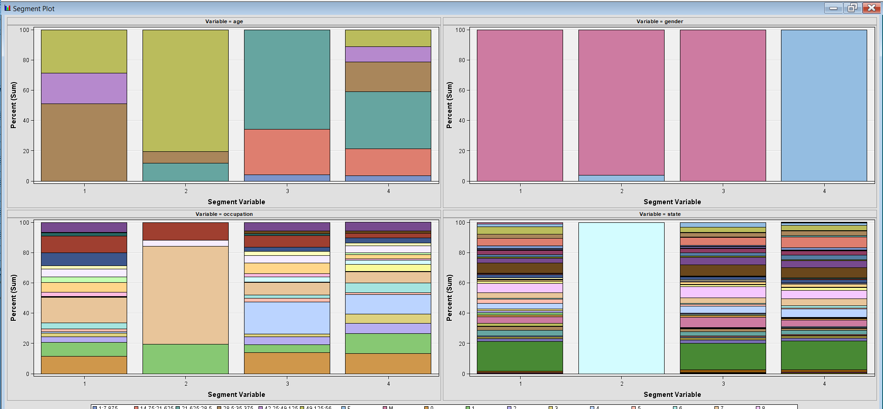
Clustering Results
80% of age 49
96% are male
100% from MS state
64% from occ -7

Slide 32
Agenda
Variable correlations and distributions
Dataset transformation and cleaning
Unsupervised learning
Supervised learning
Conclusions and future steps

Slide 33
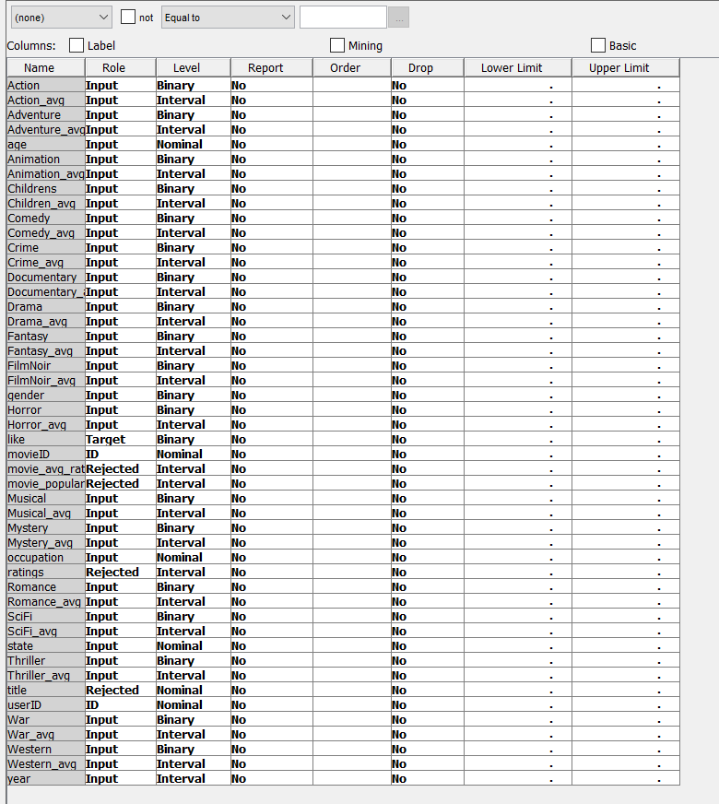
Supervised Model Inputs

Slide 34
Decision Tree
Imputed missing values for action_avg, drama_avg, etc. with 0
Partitioned data into 70% training set, 30% validation set
Attempted to predict “like” (whether the user will like or will not like a movie) using all variables as input
Tested both 2-node and 3-node decision trees

Slide 35
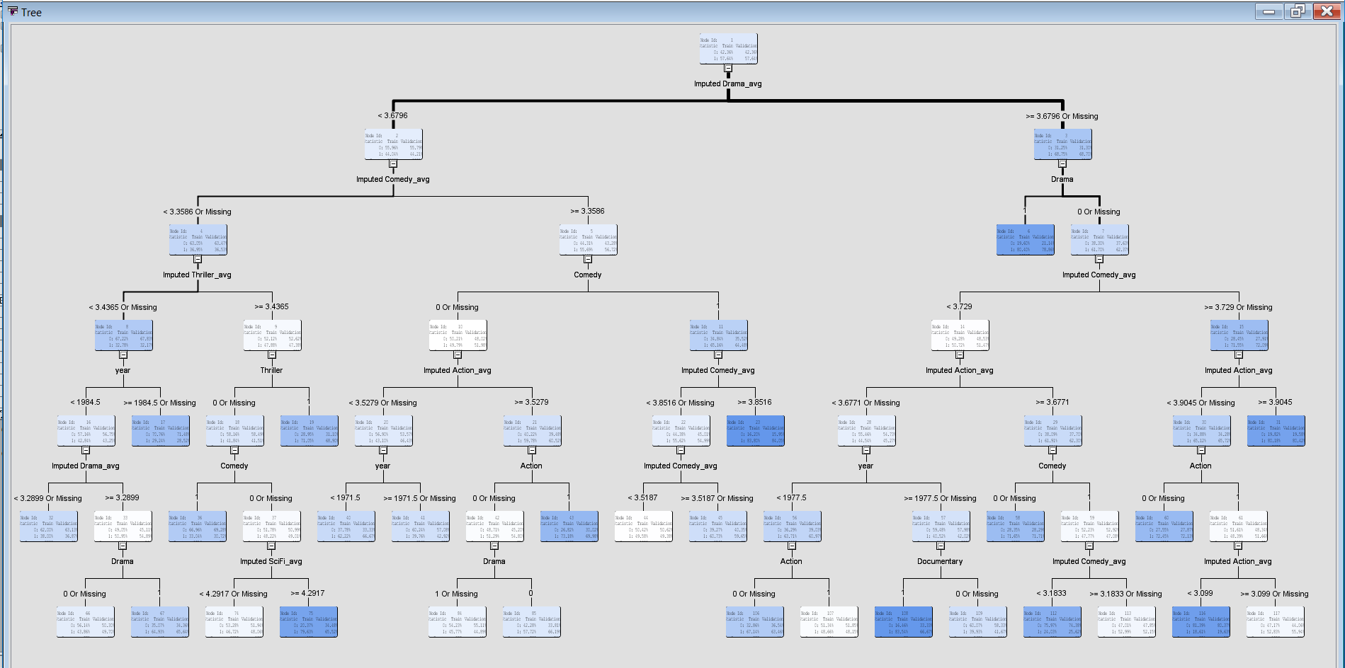
Decision Tree

Slide 36
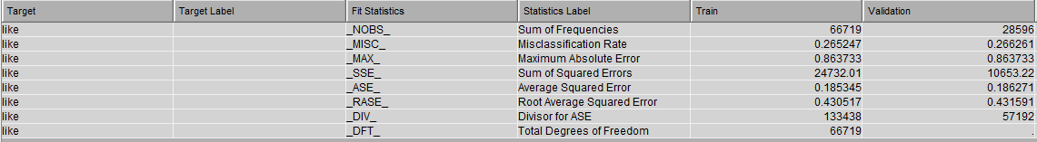
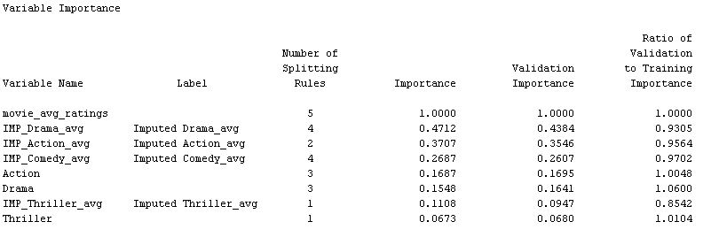
Decision Tree (2 nodes)

Slide 37
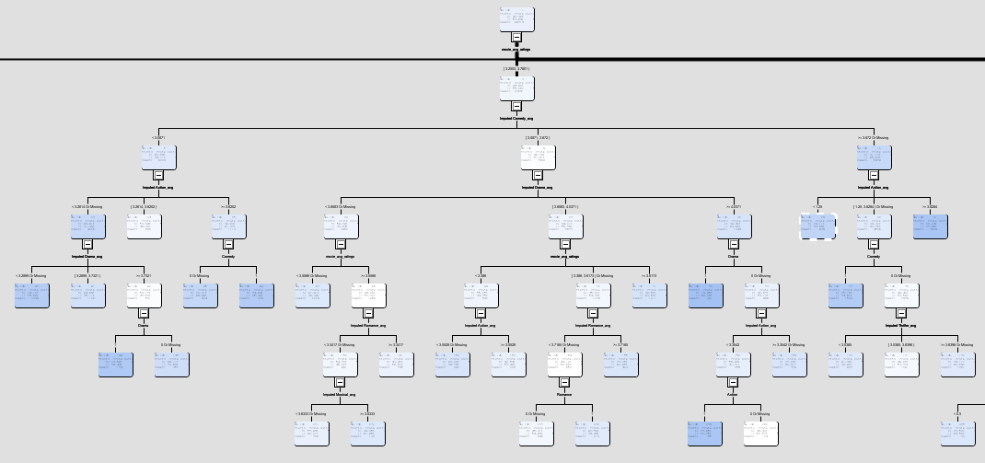
Decision Tree (3 nodes)

Slide 38
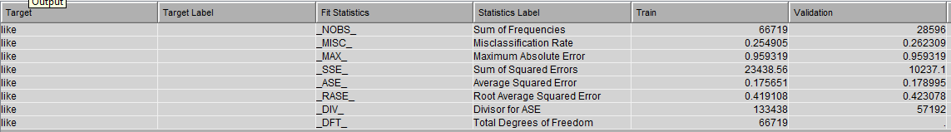
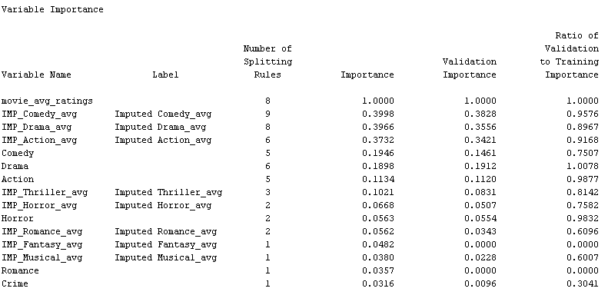
Decision Tree (2 nodes)

Slide 39
Neural Network
Partitioned data into 70% training set, 30% validation set
Attempted to predict whether a user will like or will not like a movie using all variables as input

Slide 40
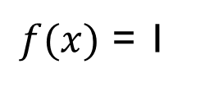
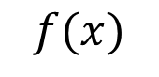
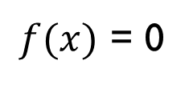
Neural Network
Hidden Layers
Input
Output
$f(x)$ = 1
Year of the movie
Age of the user
$f(x)$ = 0
Gender of the user
$$f(x)$$

Slide 41
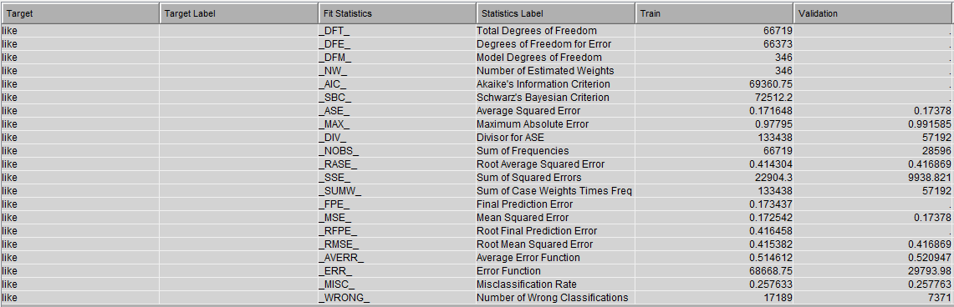
Neural Network

Slide 42
Logistic Regression
Imputed missing values for user’s average rating on each genre with 0, assuming that if they’ve never watched a genre, they most likely don’t like that genre
Partitioned data into 70% training set, 30% validation set
Attempted to predict “like” (whether the user will like or will not like a movie) using all variables as input
Used stepwise model selection
Transformed year, movie_avg_rating, and user's average rating for each genre with square root transformation because they were heavily skewed

Slide 43
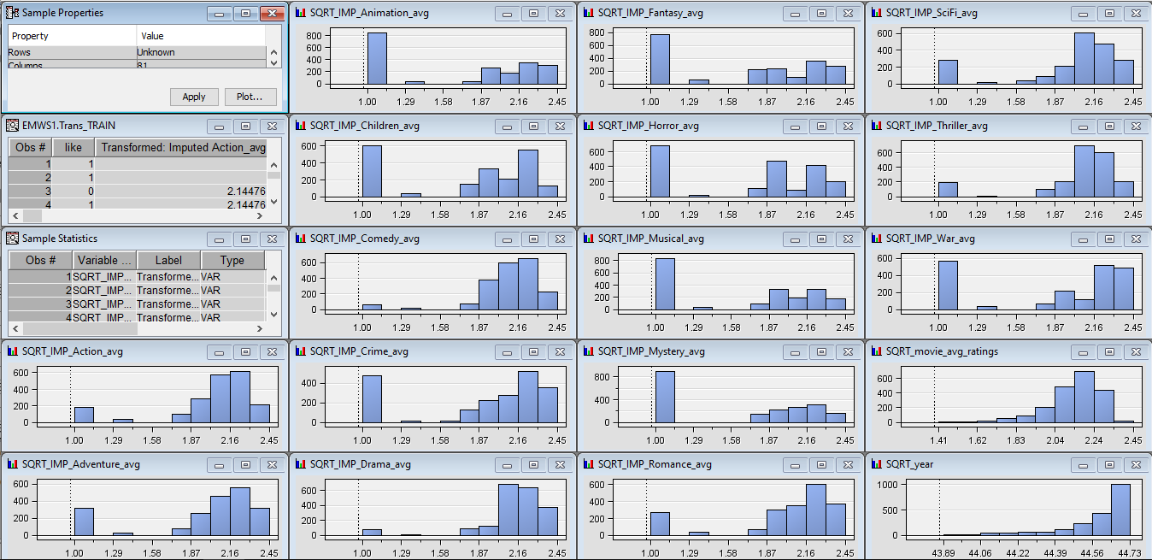
Logistic Regression - Transformed Variables

Slide 44
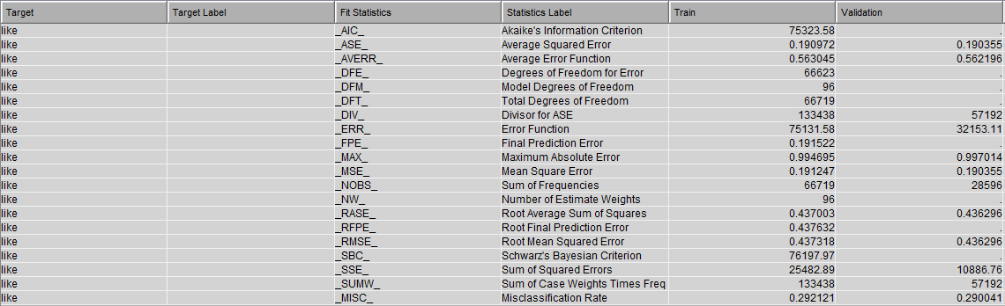
Logistic Regression

Slide 45
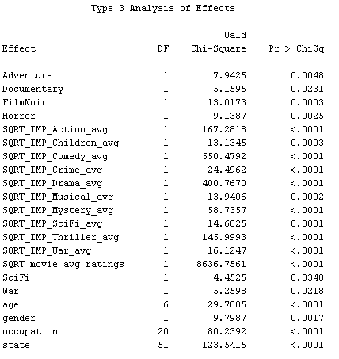
Logistic Regression

Slide 46
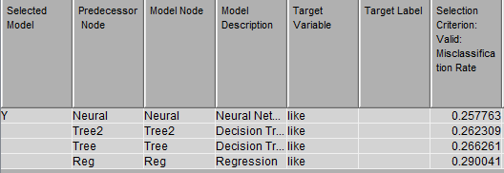
Supervised Model Comparison

Slide 47
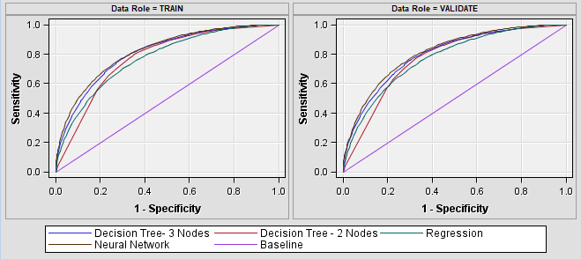
Supervised Model Comparison

Slide 48
Agenda
Variable correlations and distributions
Dataset transformation and cleaning
Unsupervised learning
Supervised learning
Conclusions and future steps

Slide 49
Conclusion
Association rules can help us predict if a user will like a movie based on other movies they’ve already rated highly
Clustering users based on demographics can help us recommend movies based on what other users in the same cluster have rated highly
Neural networks have the lowest misclassification rate of all supervised models tested, allowing us to predict whether a user will like a movie with an accuracy of 74.2237%
The most important variables in predicting whether a user will like a movie are average rating of a movie (over all users), the user’s average rating on different genres (drama, action, comedy, etc.), the genre of the movie, user’s age, occupation and state

Slide 50

Next Steps
Improving the data set and adding more variables
Text tags were provided with the data set. Text mining or sentiment analysis with these tags could help us determine which words are associated with higher ratings, as well as give us more information about why a user liked or did not like a movie.
The ID for the each movie on IMDB was provided with the data set, which could be used to scrape more information about each movie from IMDB.com
Additional models could be tested, such as SVM and ensemble methods

Slide 51
